Slide 1
EVOLVE 6B – 5.1

Slide 4
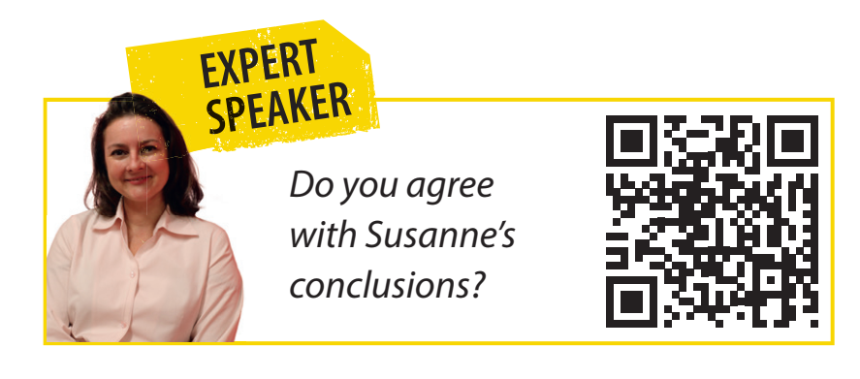

Slide 19
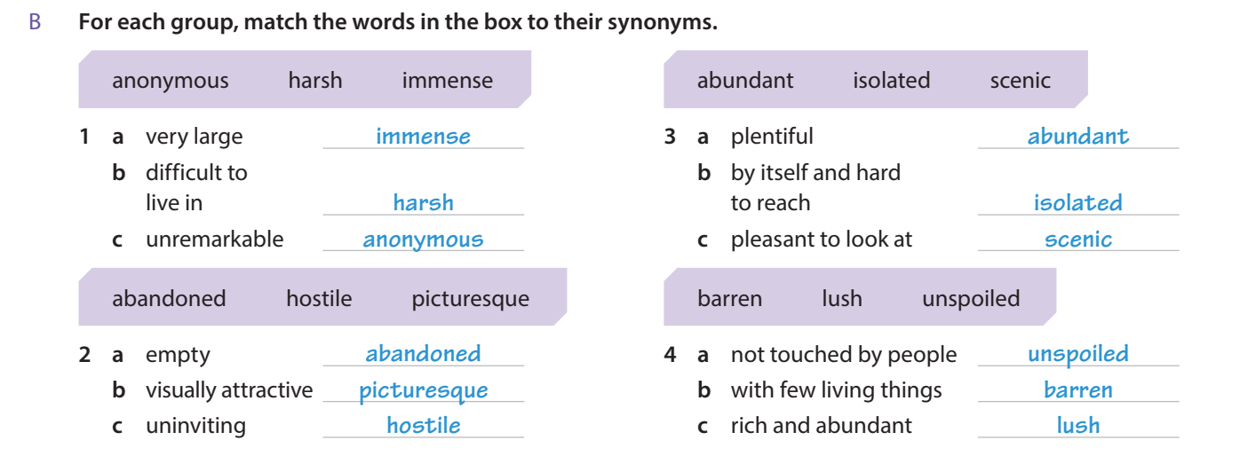

Slide 22
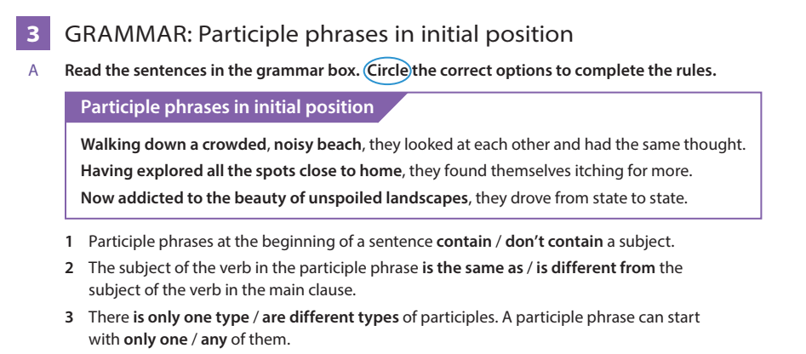

Slide 25
