Slide 1
EVOLVE 6B – 5.3

Slide 4
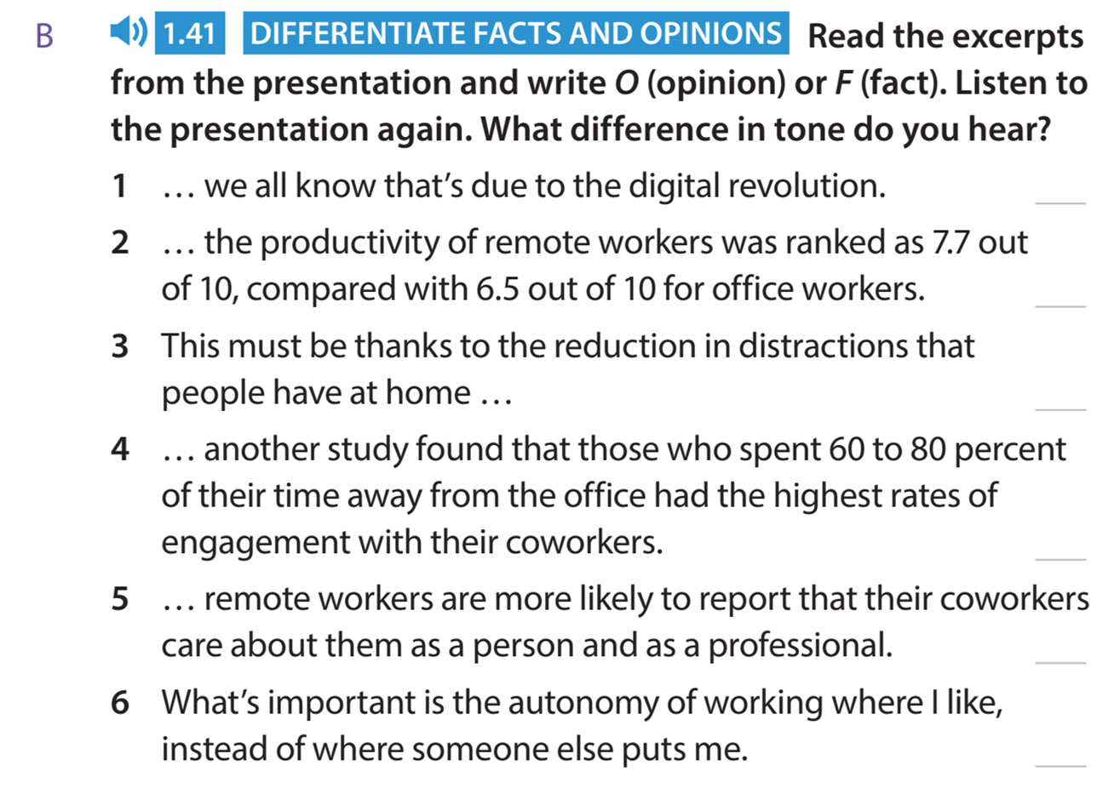

Slide 18
