Slide 1
Evolve 6B-6.5

Slide 4
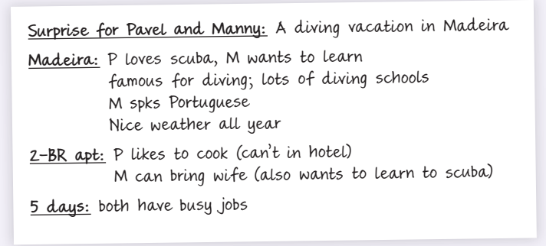

Slide 8
