Slide 1
Evolve 6B-7.2

Slide 23
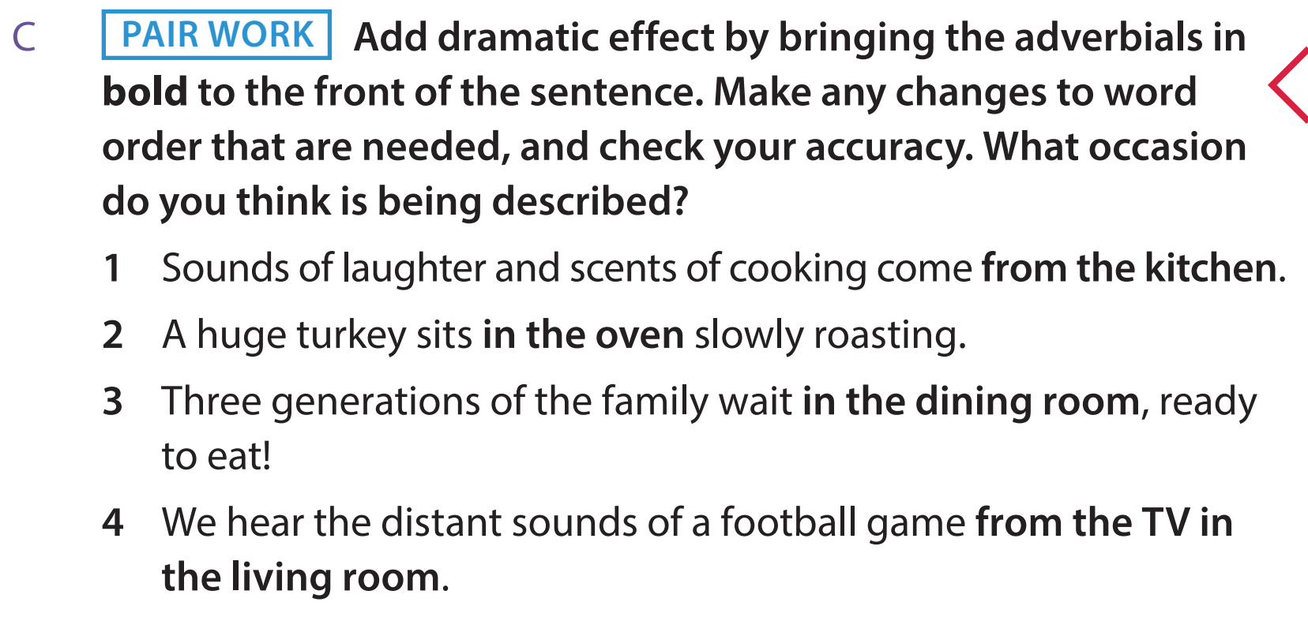

Slide 26
