Slide 1




Evolve 6C 9.4

Slide 2




Slide 3


Slide 4


Slide 5
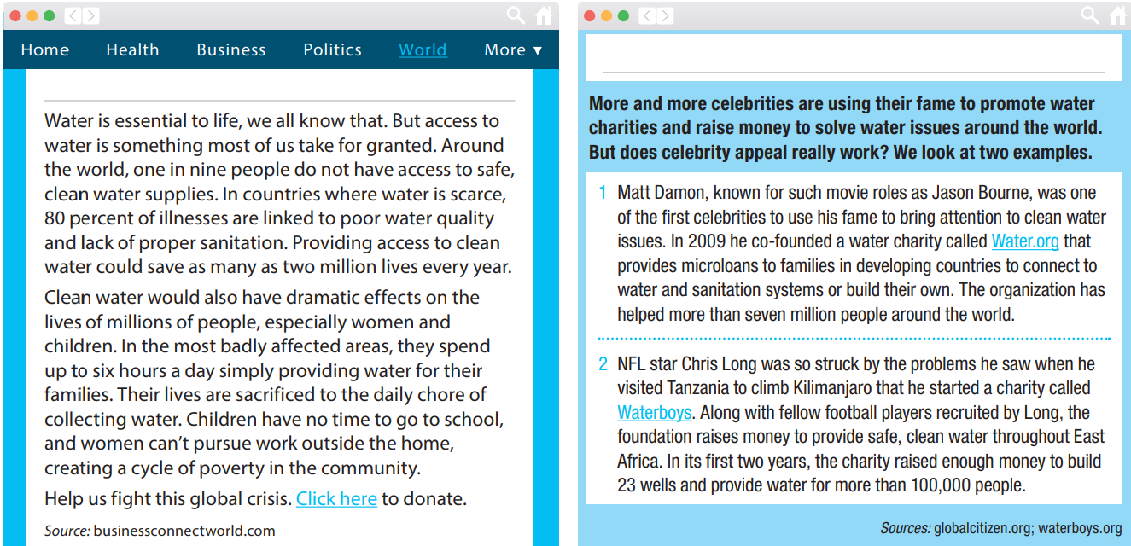

Slide 6


Slide 7
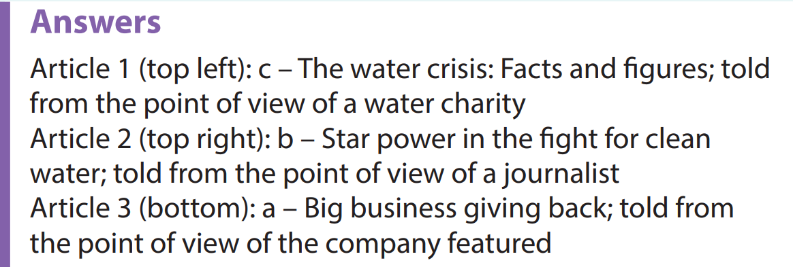

Slide 9


Slide 10


Slide 11
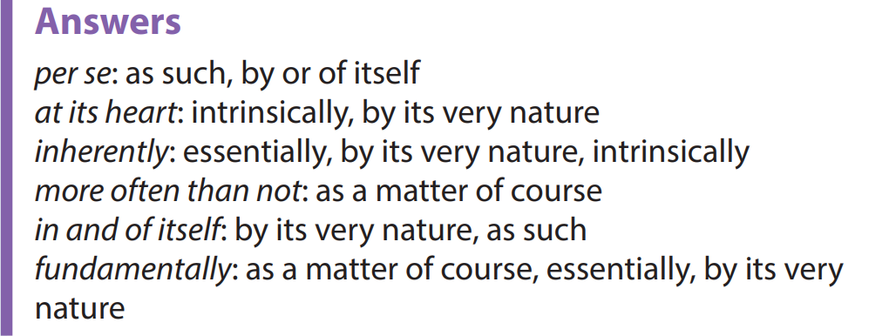

Slide 12


Slide 13



Slide 14

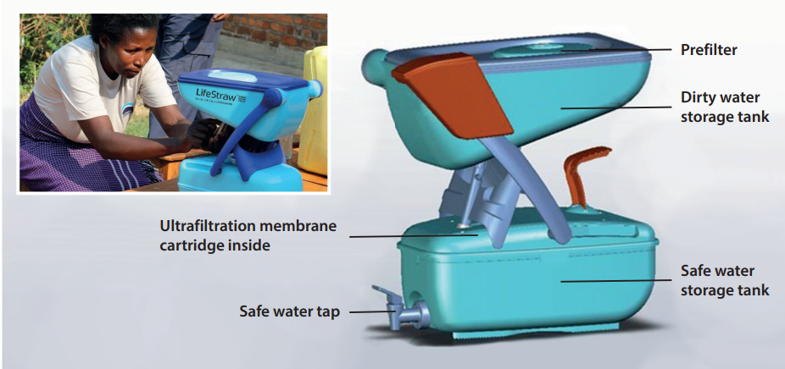

Slide 15


