Slide 1




Evolve 6C-10.3

Slide 2


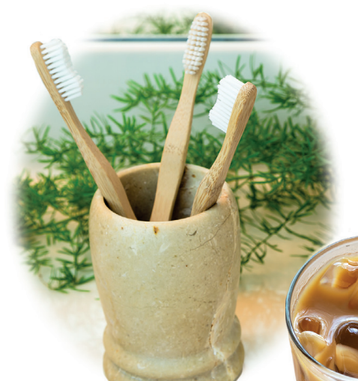


Slide 3


Slide 4
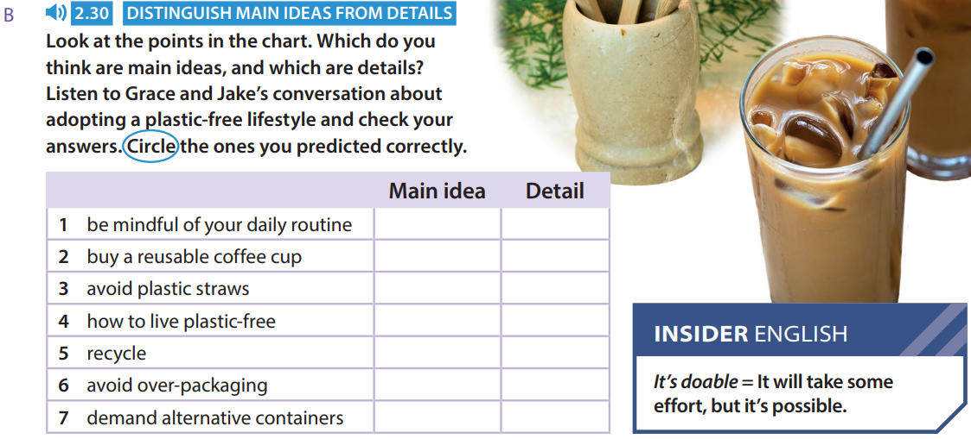

Slide 5


Slide 6


Slide 8


Slide 10


Slide 11


Slide 13



Slide 14


Slide 15


Slide 16
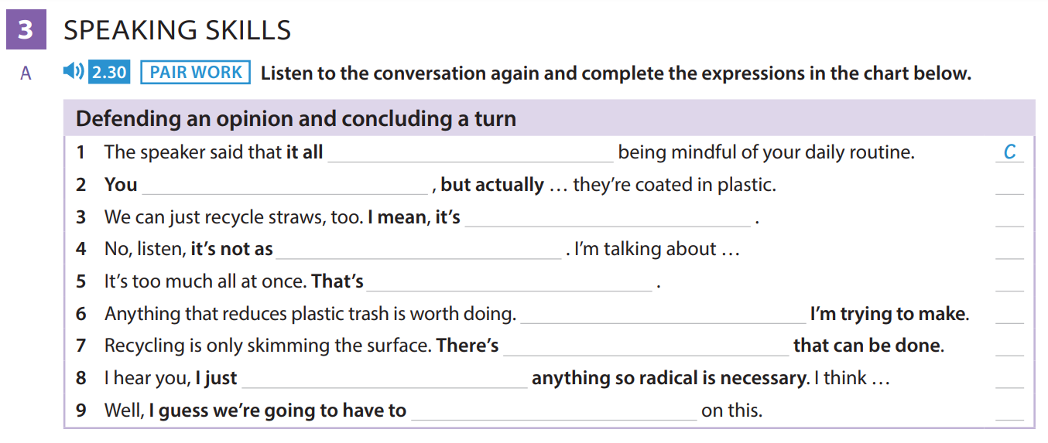

Slide 18


Slide 20


Slide 21

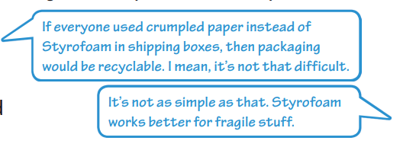

Slide 22




Slide 24


Slide 26
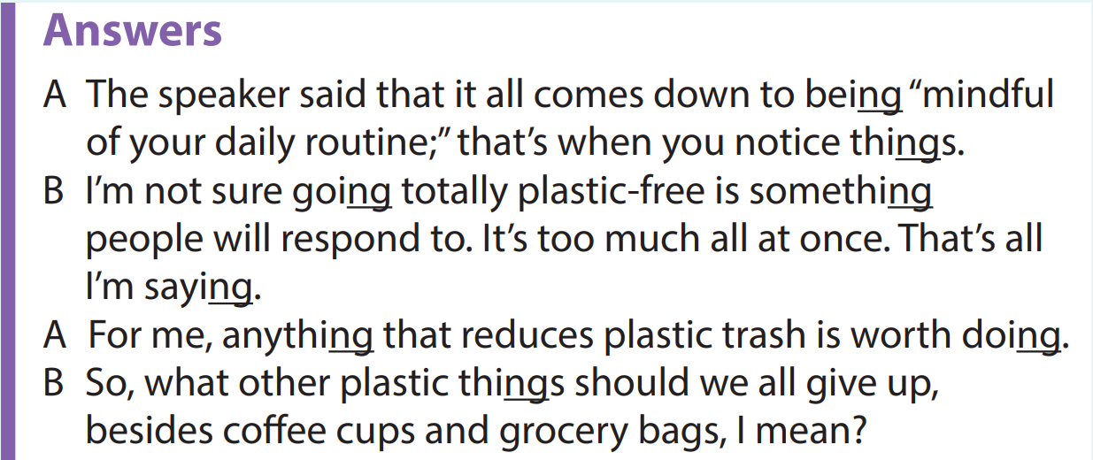

Slide 28


Slide 29


