Slide 1
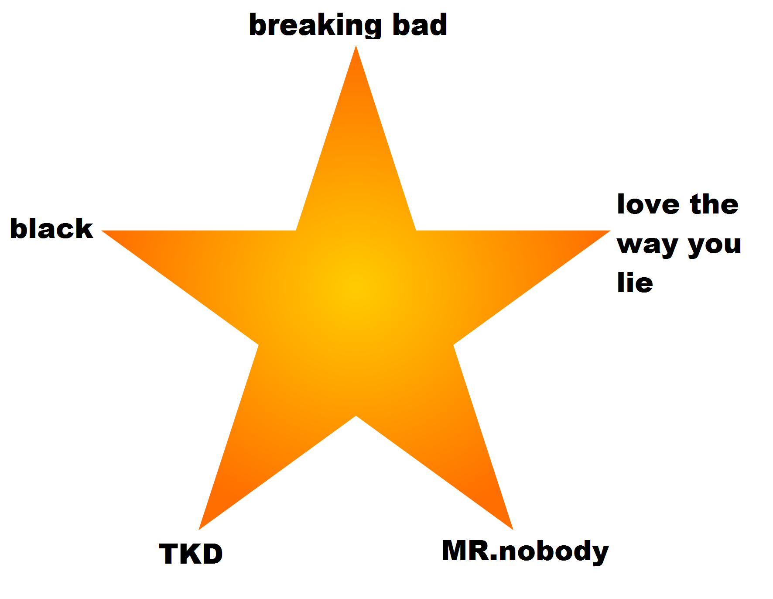

Slide 2
What Is your dream job?

Slide 3
I want to be next president of USA
What are the things that I must do in order to win this competition

Slide 4
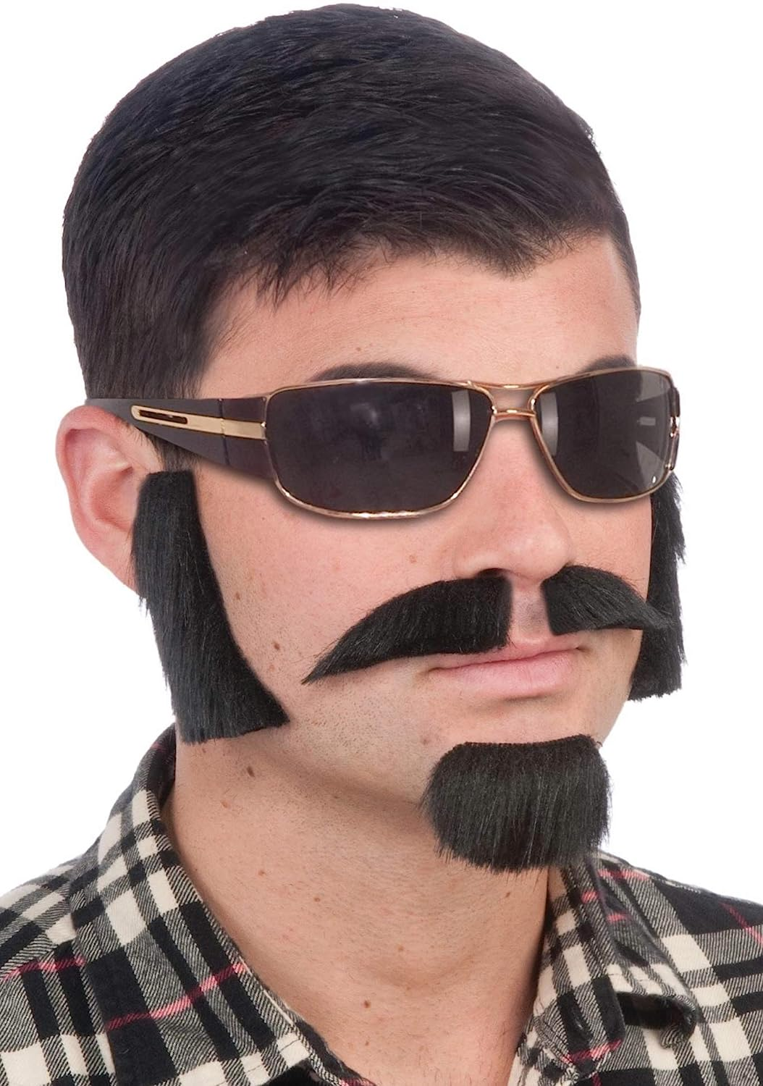

Slide 5
Deceive
Disguise
Fabricate
Distort
Cheat

Slide 6
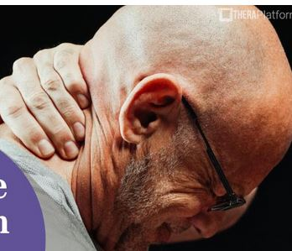
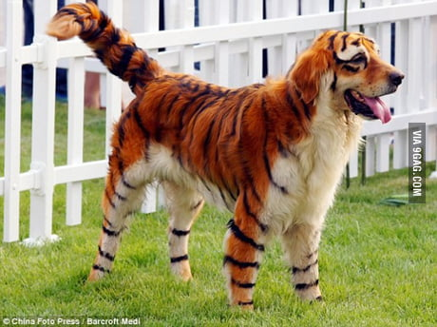

Slide 7
Fib
Manipulate
mislead
Own up
Pass off as
reveal

Slide 11
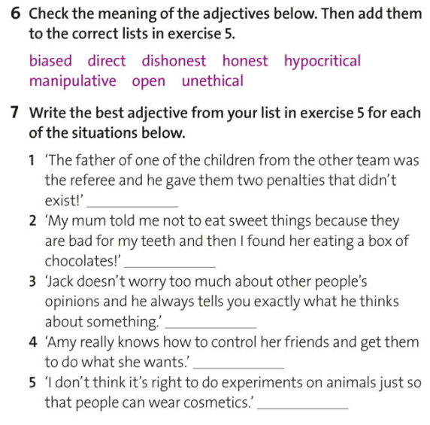

Slide 12
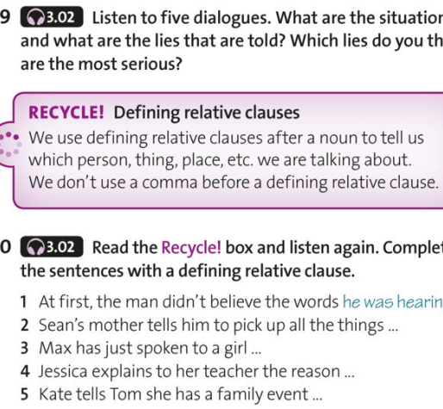

Slide 13
