Slide 1
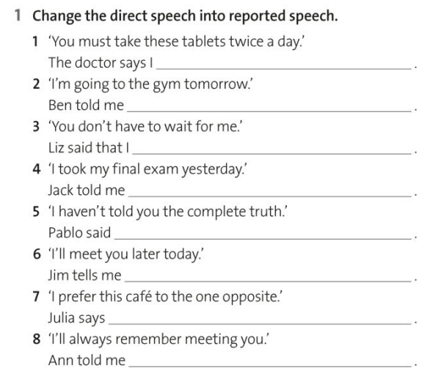
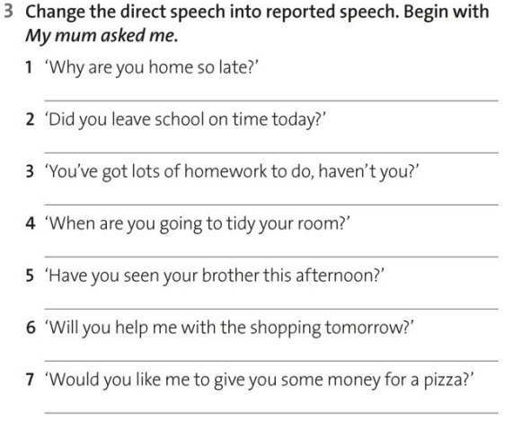

Slide 3
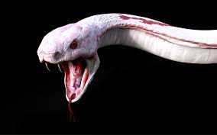

Slide 4
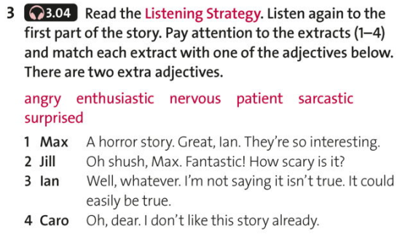

Slide 5
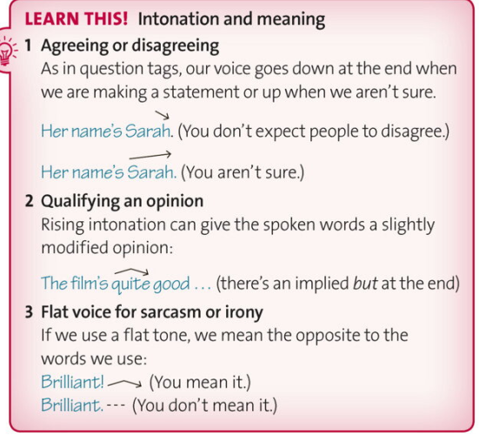
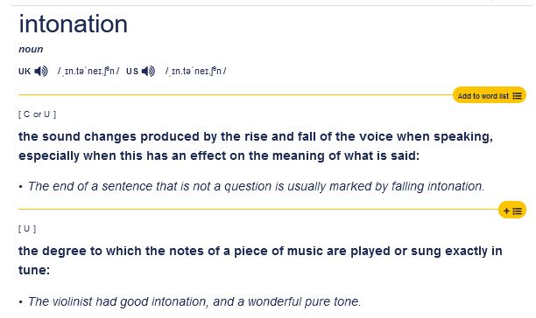

Slide 6
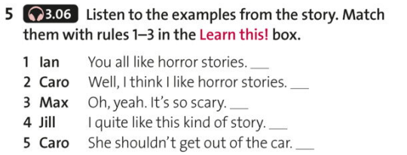
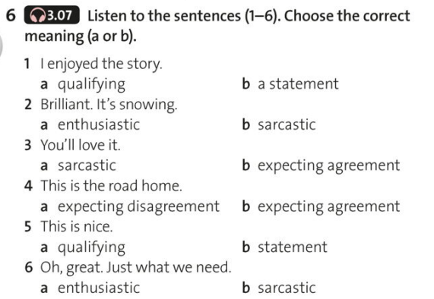

Slide 7
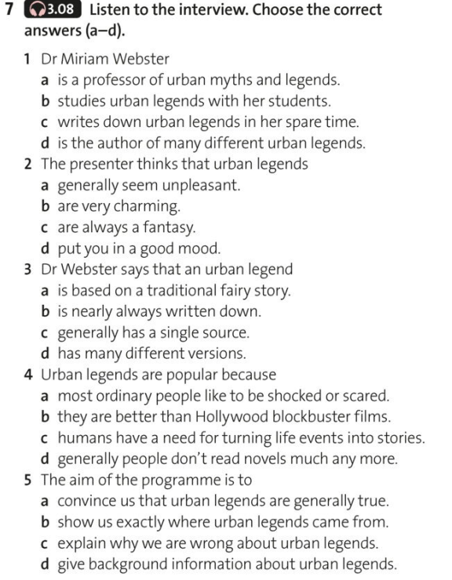
Myths
invariably
implied moral message
spontaneously

Slide 8
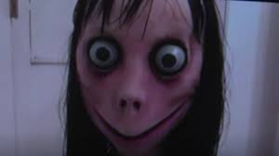
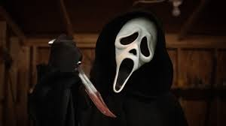

Slide 9
1 Can you play a musical instrument?
2 How many times have you been abroad?
3 Did you go to bed early last night?
4 What do you usually have for breakfast?
5 Are you going to go out on Saturday night?
6 Have you ever won a prize or trophy?
7 What are you going to do after class?
8 What's your favorite time of year?
9 When did you last get a letter written by hand?
10 What do you do on Sunday mornings?

