Slide 1
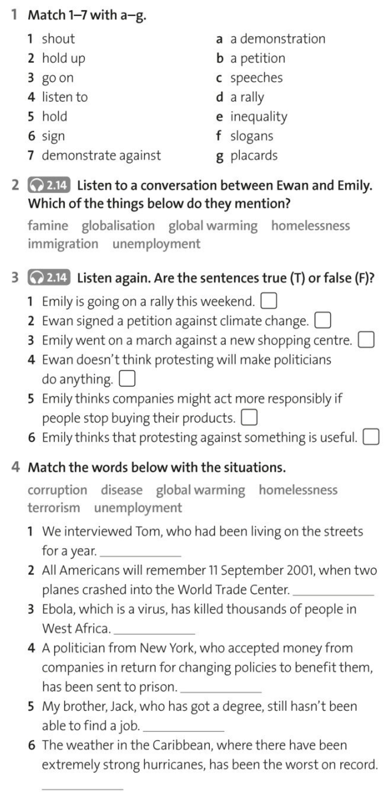
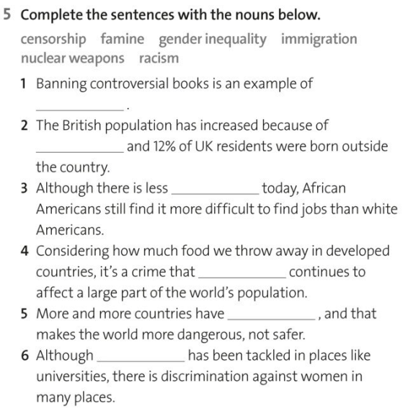

Slide 2
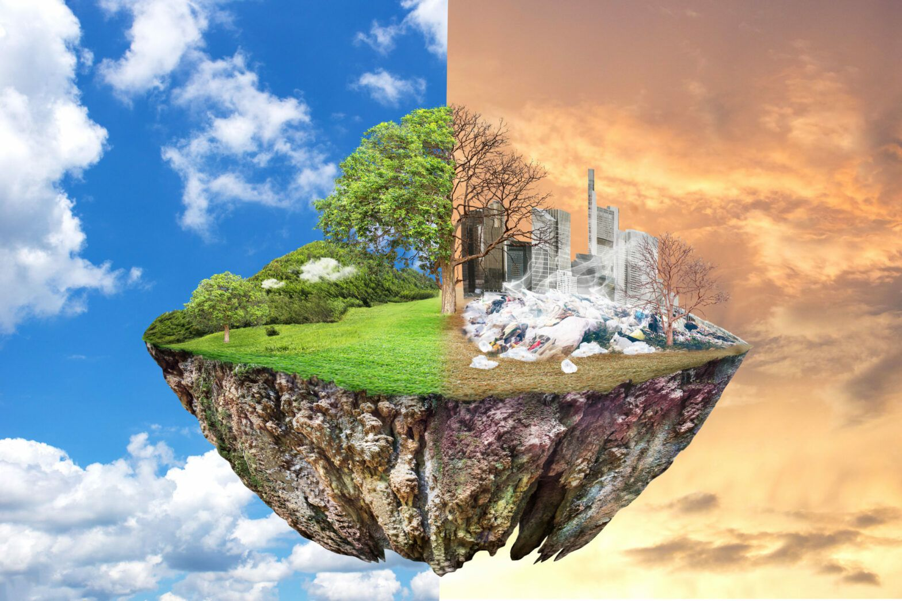
Global warming
Myth or real

Slide 3
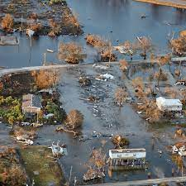
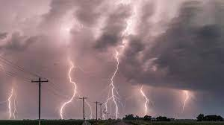
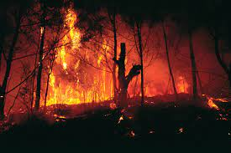

Slide 4
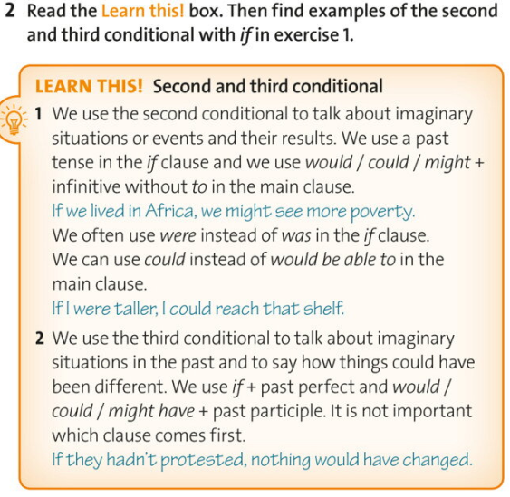

Slide 5
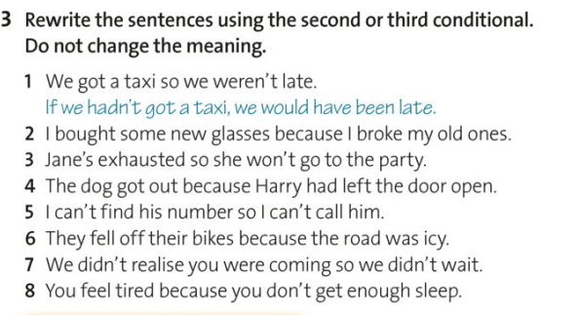
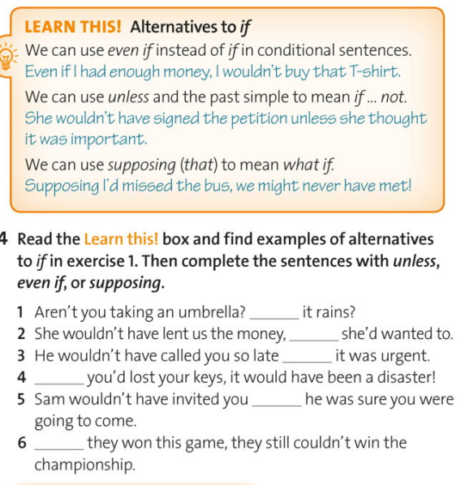

Slide 6
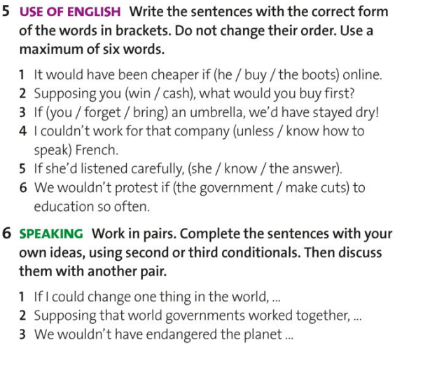
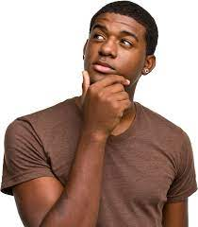

Slide 7
SECOND CONDITIONAL DISCUSSION
STUDENT B’s QUESTIONS (Do not show these to student A)
1) If you told me all of your secrets, would I be shocked?
2) If you changed your name, what name would you choose?
3) If you could speak three other languages. What would they be?
4) If you could decide what happens in your life tomorrow, what would you
want to happen?
5) Where would you live if you could live anywhere in the world?
6) If a natural disaster hit your town, what would you do?
7) If you became a rock star, what kind of songs would you sing and what
image would you have?
8) If the world was going to end at 3.37 tomorrow afternoon, what would
you do up until that time?
9) If you were the world’s best at something, what would you like to be
best at?
10) If you were a colour, what colour would you be and why?

Slide 8
What would you have done if it had been raining heavily this morning?
If winter had been hot and summer had been cold this past year, what would you have thought?
If you had had private tutors throughout your schooling, how would your life have been different?
If you had been born in Los Angeles, how would your life have been different?
If you had been great at sports, how would your life have been different?
What would have happened if you had been a Mozart-level musical prodigy?
If you had been framed for a crime that you didn’t commit, what would you have done?
If Russia had landed on the moon before the United States, how would history have been different?
What would you have worn if it had been freezing cold when you woke up?
Who would you have told if you had won the lottery last Saturday?
If you had accidentally broken your friend’s laptop, what would you have told them?
If you had mistakenly walked out of a store without paying for something and gone home, what would you have done about it?
What would you have done if some criminals had robbed the bank while you were there?
If Germany, Japan, and Italy had won World War Two, how would the world have changed?
What would you have said to the waiter if he had given you the wrong food?
If you had known then what you know now, which major would you have chosen at school?

