Slide 1
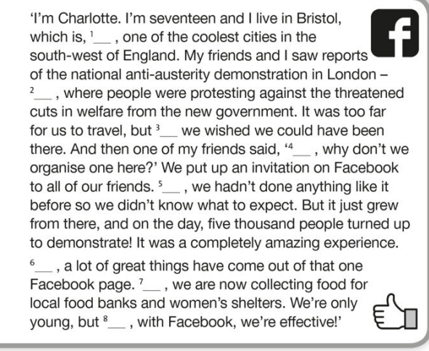
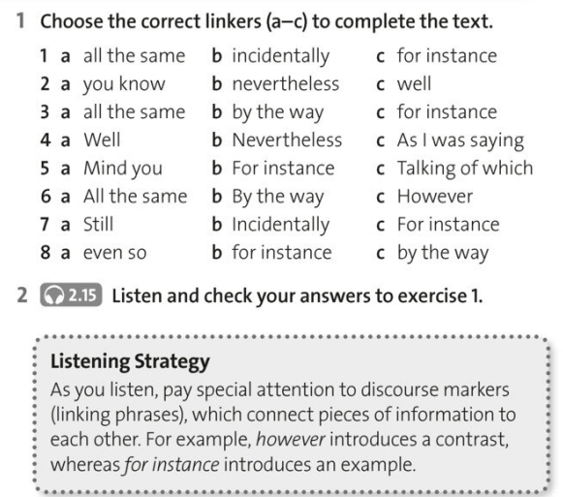

Slide 2
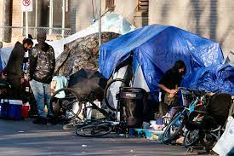
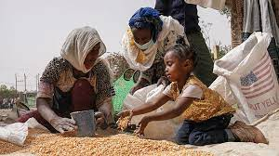
It is imperative for individuals to take action towards ending homelessness and famine in their region.
What can be done?
What are your suggestions?

Slide 3
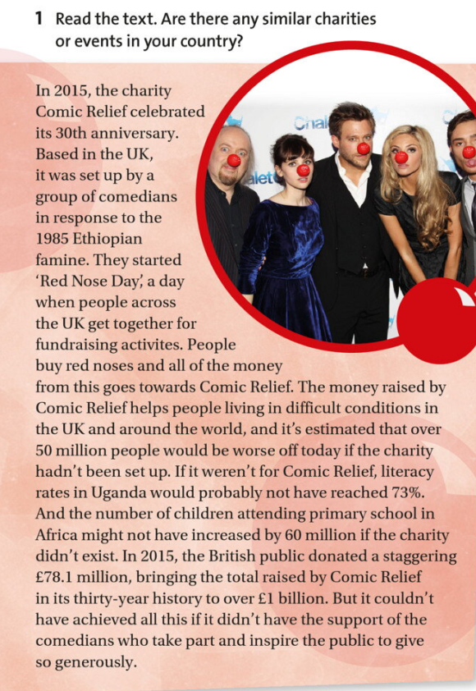

Slide 4
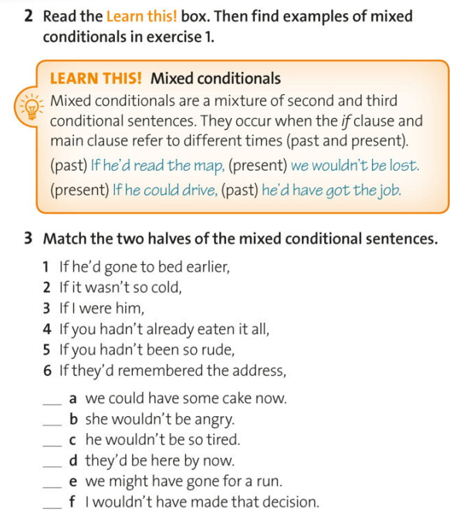
Example

Slide 5
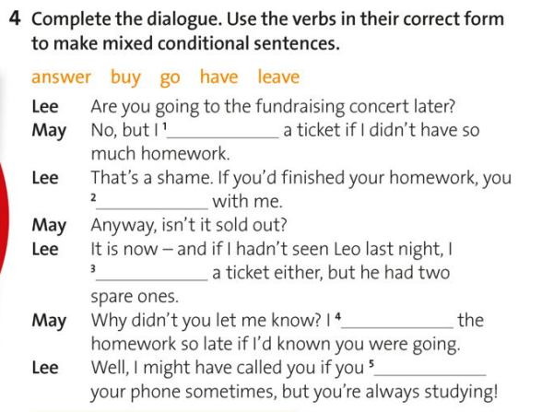
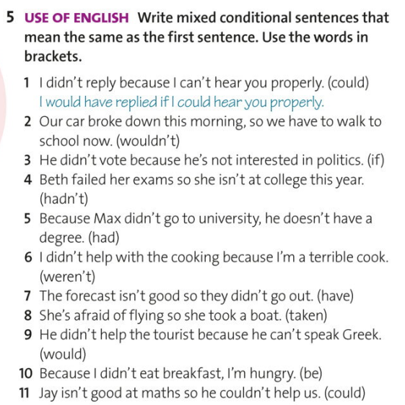

Slide 6
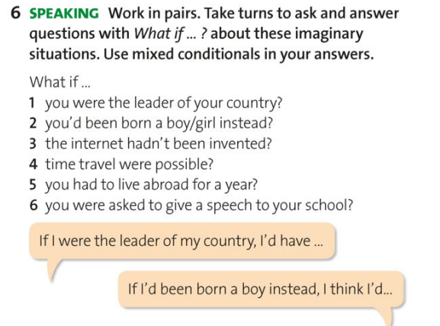
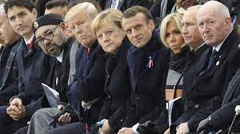
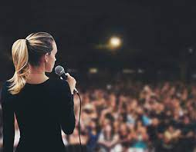

Slide 7
Mixed conditional
Type 1: if + past perfect. would + base form
Type 2: if + simple past. would + have + p.p
If you had been born into a rich family, how would your life be different now?
If the Allies hadn’t won World War II, what sort of world would we live in?
If your country’s leader hadn’t come to power, would your country be in a better position right now?
If you had studied something different at school or university, how would your life be different today?
If the internet hadn’t been invented, would the world be a better place?
If you hadn’t got your current job, what would you be doing now?
If men hadn’t landed on the moon in 1969, would we be any worse off today?
If you had grown up in a much poorer country, how would your life be different?
If you were a millionaire, how would you have spent your last holiday?
10. If you were the opposite gender, how would your childhood have been different?
11. If you were the leader of your country, what would you have done differently in the last 5 years?
12. If you were handsome, how would your life have been different so far?

