Slide 1
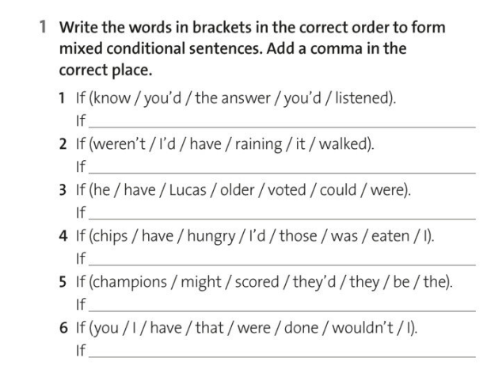
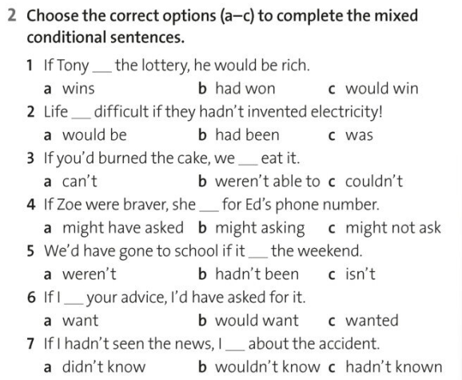

Slide 2
Mixed conditional
Type 1: if + past perfect. would + base form
Type 2: if + simple past. would + have + p.p
If you had been born into a rich family, how would your life be different now?
If the Allies hadn’t won World War II, what sort of world would we live in?
If your country’s leader hadn’t come to power, would your country be in a better position right now?
If you had studied something different at school or university, how would your life be different today?
If the internet hadn’t been invented, would the world be a better place?
If you hadn’t got your current job, what would you be doing now?
If men hadn’t landed on the moon in 1969, would we be any worse off today?
If you had grown up in a much poorer country, how would your life be different?
If you were a millionaire, how would you have spent your last holiday?
10. If you were the opposite gender, how would your childhood have been different?
11. If you were the leader of your country, what would you have done differently in the last 5 years?
12. If you were handsome, how would your life have been different so far?

Slide 3
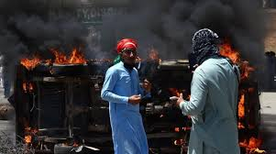
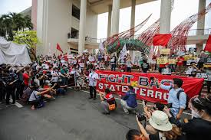
Is protesting a safe activity?
Do protests typically result in casualties?

Slide 4
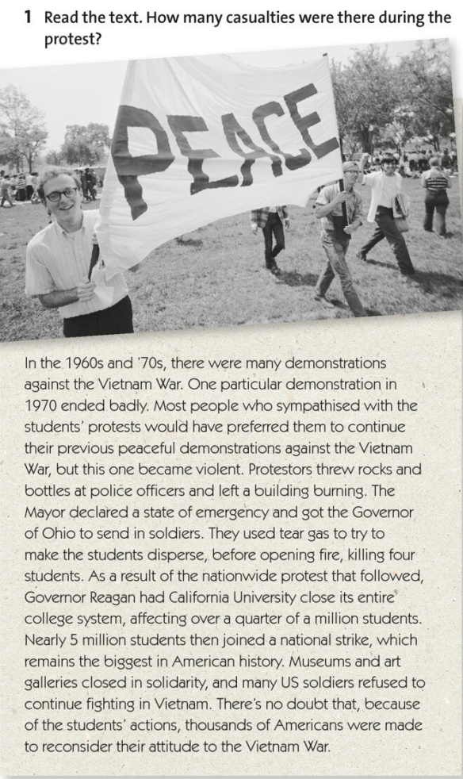
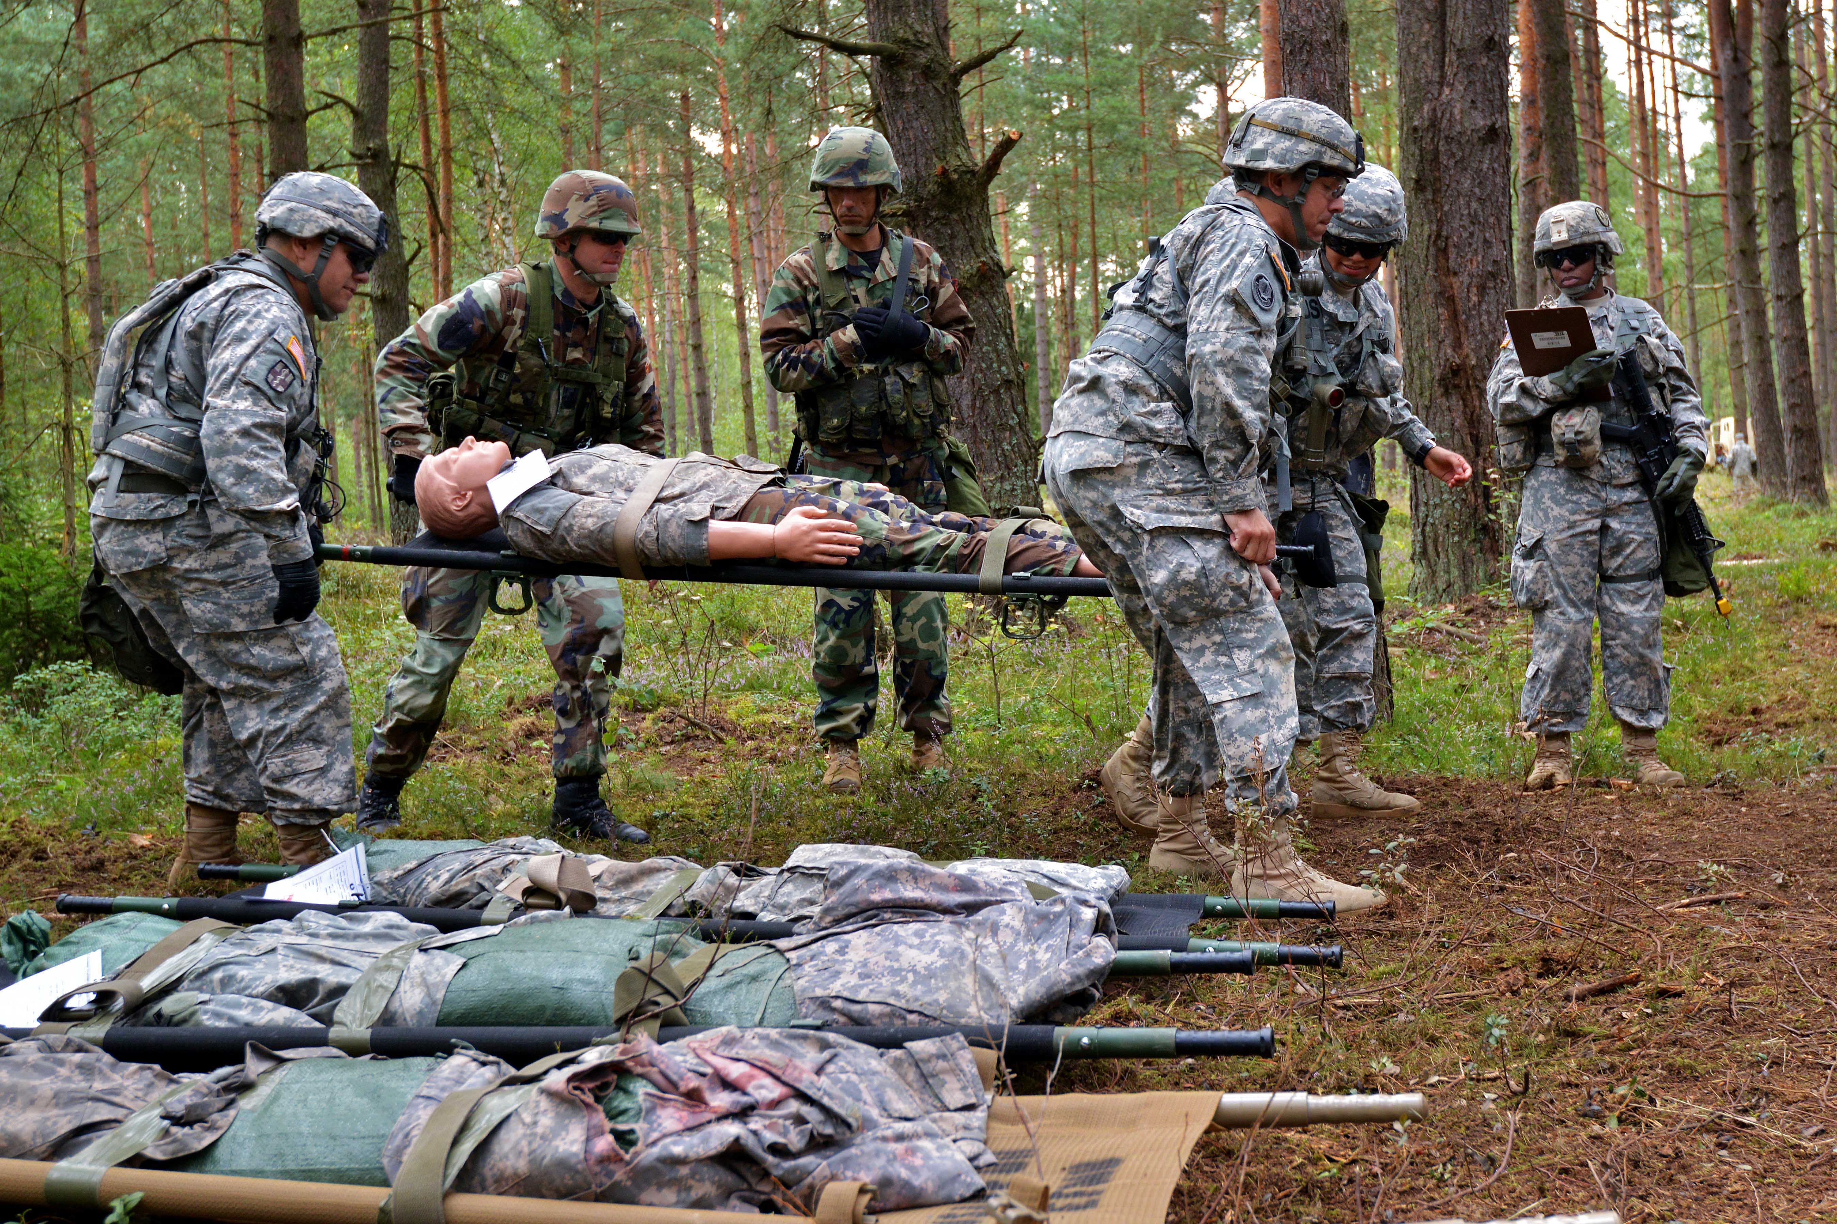
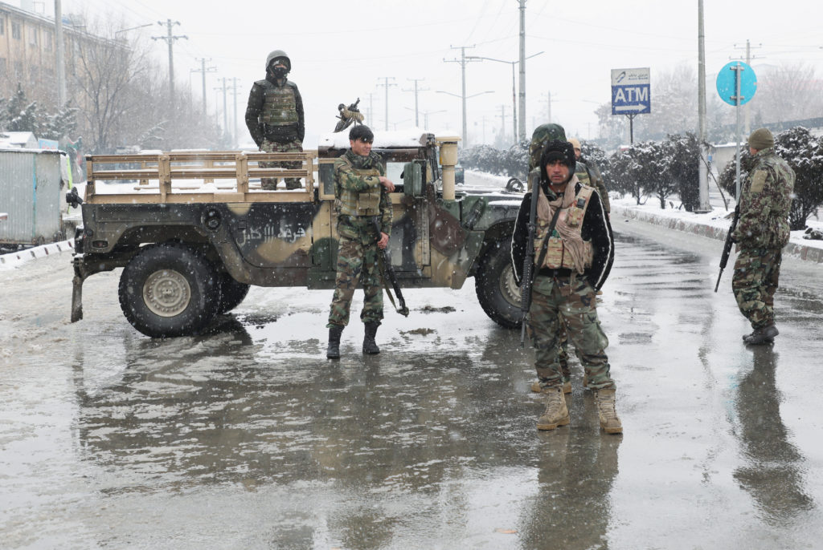

Slide 5
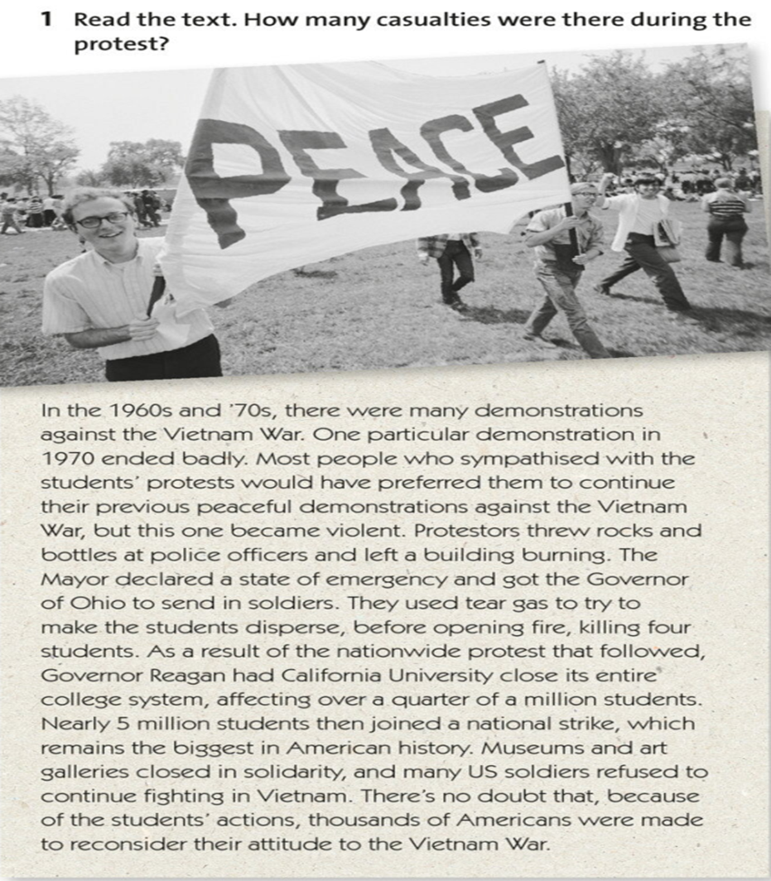
Find verbs of make / have/get

Slide 6
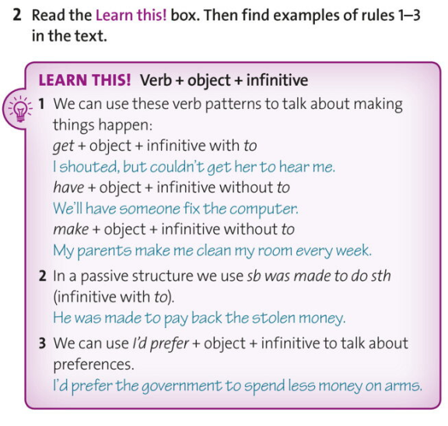
Causative

Slide 7
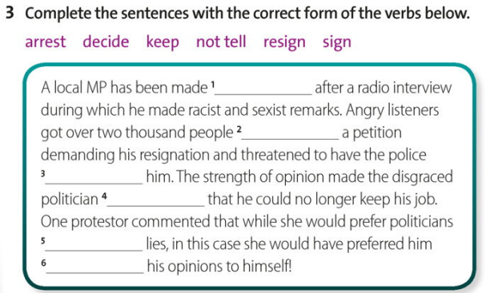

Slide 8
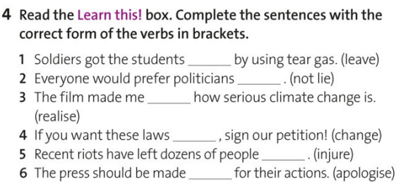
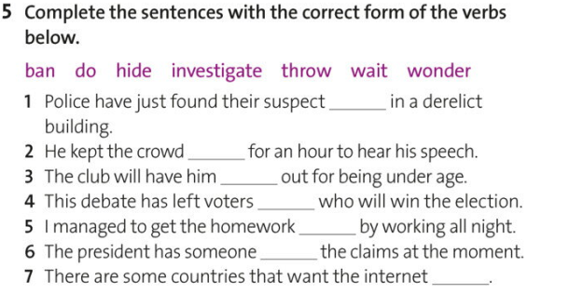

Slide 10
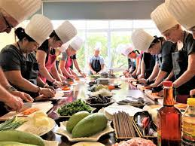
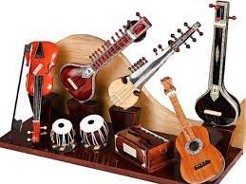
2. What caused your parents to let you stay out late?
3. What made your friend have her wedding in a different city?
4. What influenced your colleague to get her manuscript published?
5. What motivated your neighbour to hire a personal detective?
6. What drove your sister to have her car repainted?
7. What persuaded your professor to let you retake the exam?
10. What compelled your partner to get a pet dog?
1. What caused you to repaint your house?
2. What made you hire a personal trainer?
3. What led you to start learning a musical instrument?
4. What prompted you to upgrade your smartphone?
5. What influenced you to sign up for a cooking class?
6. What drove you to get your car serviced?
7. What persuaded you to adopt a healthier lifestyle?
9. What encouraged you to invest in gold?
10. What compelled you to hire a cleaning service for your home?

