Slide 1
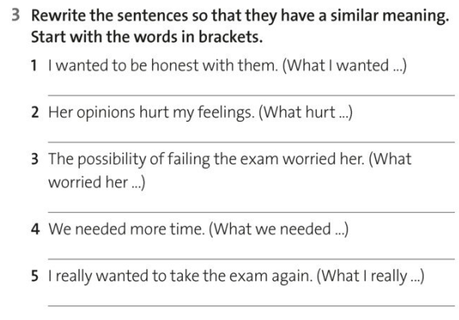

Slide 3
You are going to make a story with each other but every person can say just one word …
Good luck =)

Slide 4
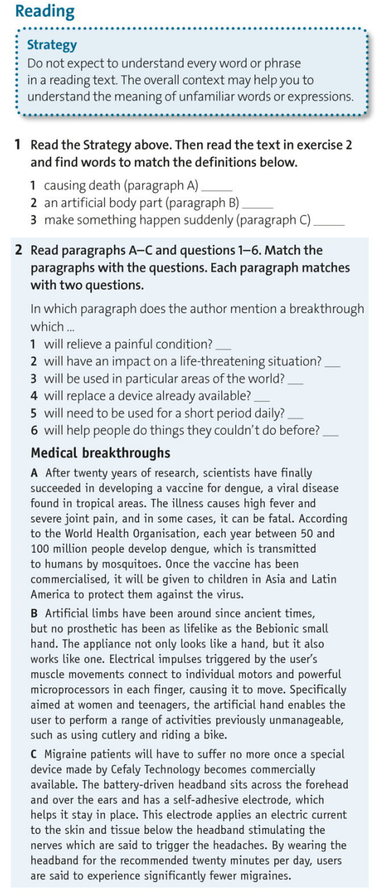

Slide 5
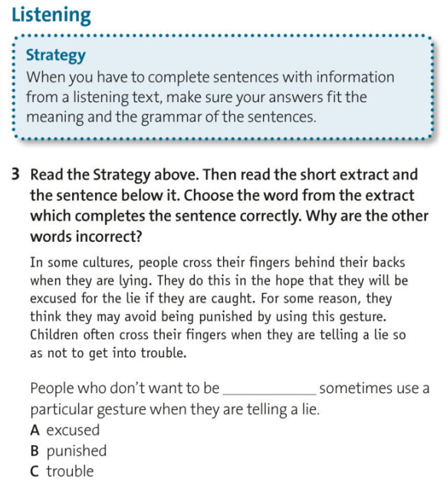
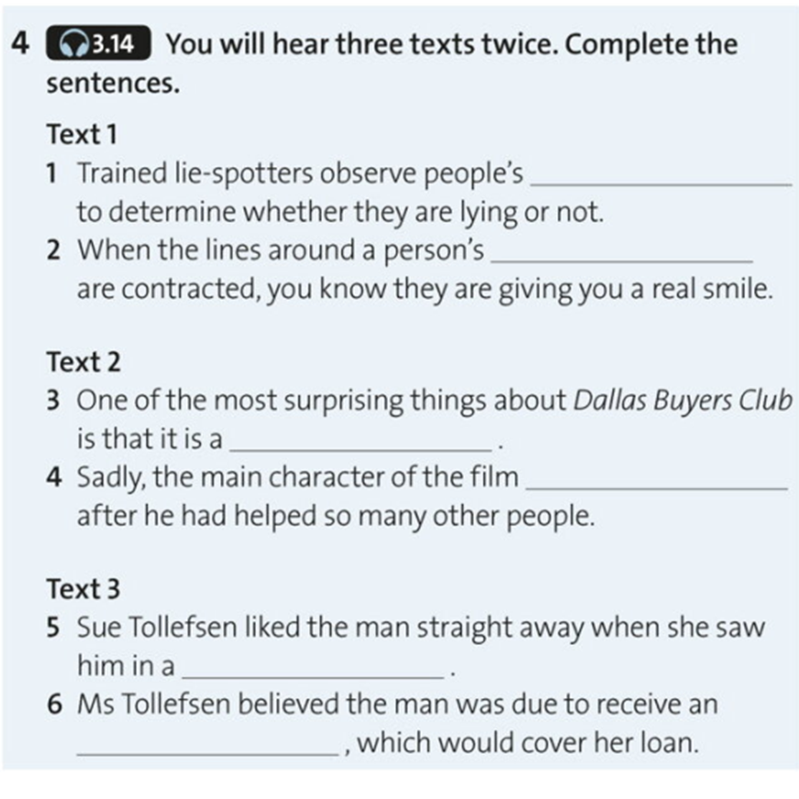

Slide 6
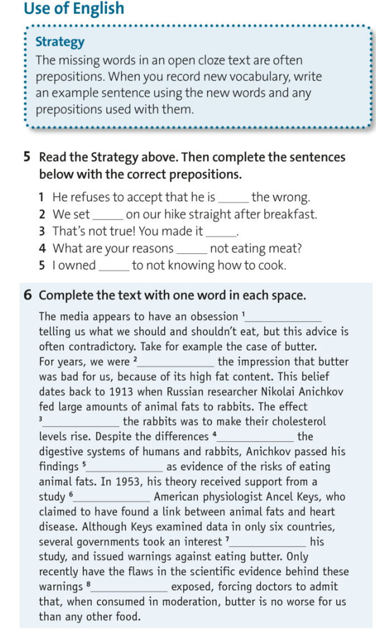
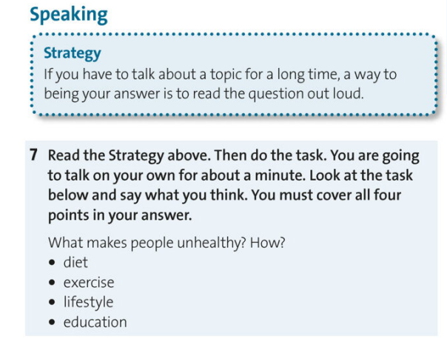

Slide 7
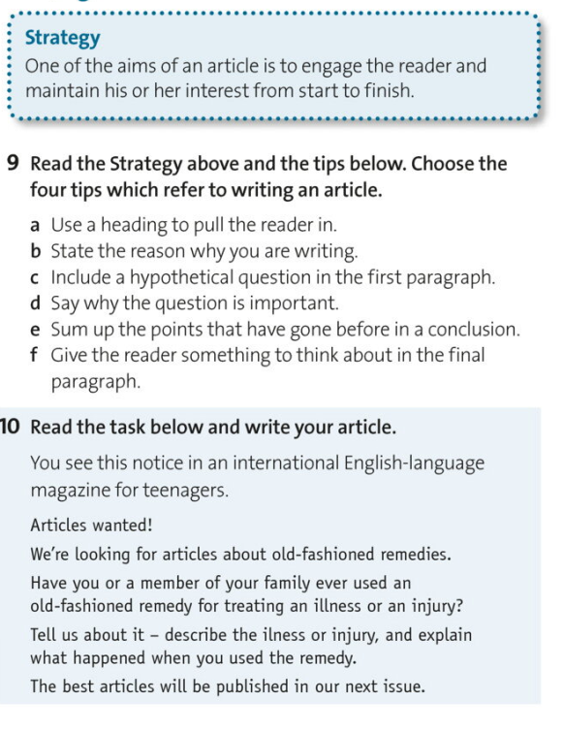

Slide 8
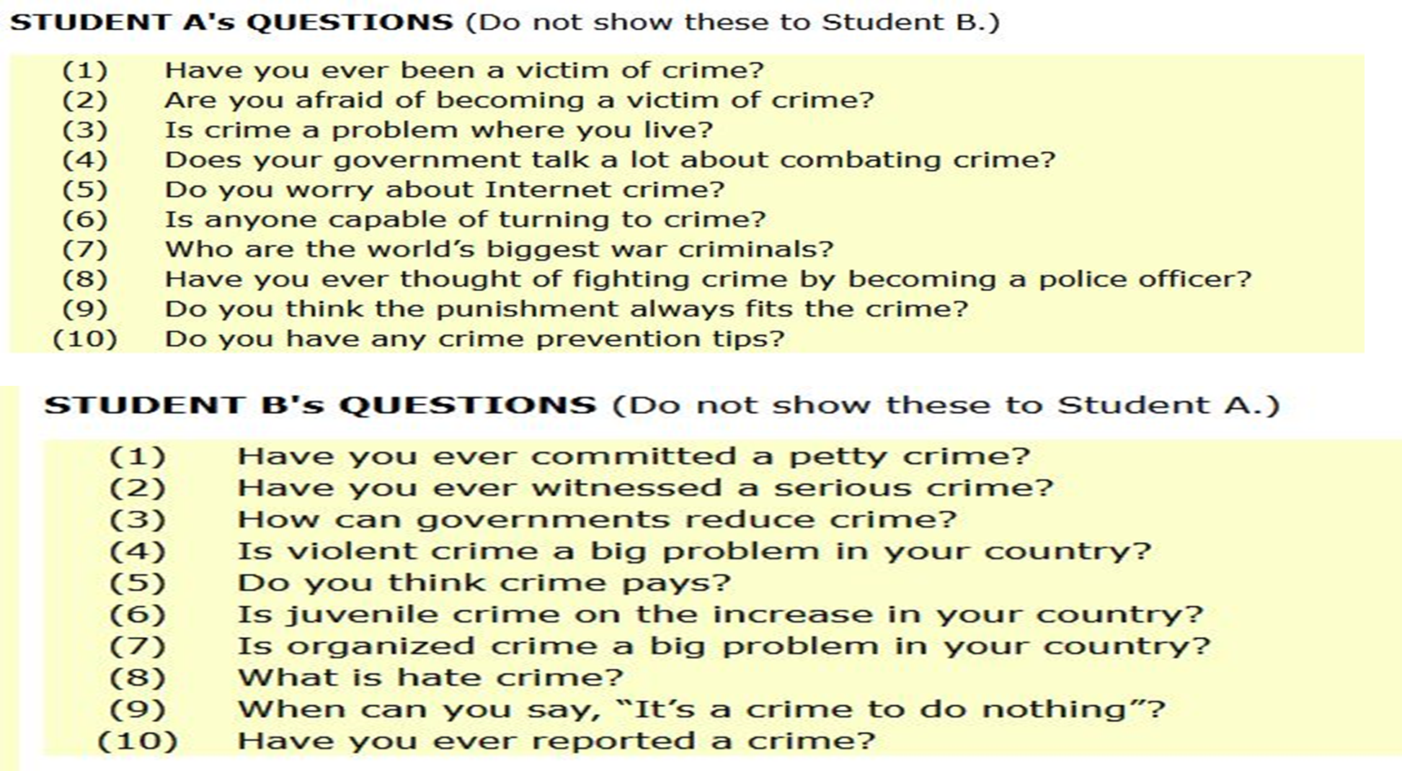

Slide 10
Scientists tell us that some activities are good for health and others are wrong. Despite knowing that, millions of people continue doing unhealthy activities. What are the causes and what are the solutions for this?
Introduction
Paraphrase the topic of the essay.
Clearly state the intent of the essay and what could be expected from it

Slide 11
Scientists tell us that some activities are good for health and others are wrong. Despite knowing that, millions of people continue doing unhealthy activities. What are the causes and what are the solutions for this?
Introduction
Paraphrase the topic of the essay.
Clearly state the intent of the essay and what could be expected from it
Modern people are regularly informed about the dangers of leading unhealthy lifestyles. Despite the spectacular advances in the medical field, many people are still suffering from and being killed by diseases, most of which are preventable.
.

Slide 12
Scientists tell us that some activities are good for health and others are wrong. Despite knowing that, millions of people continue doing unhealthy activities. What are the causes and what are the solutions for this?
Introduction
Paraphrase the topic of the essay.
Clearly state the intent of the essay and what could be expected from it.
Modern people are regularly informed about the dangers of leading unhealthy lifestyles. Despite the spectacular advances in the medical field, many people are still suffering from and being killed by diseases, most of which are preventable.
There are some reasons why there is still a prevalent habit of doing unhealthy activities. This can be, firstly, explained by the fact that most people are prone to undue optimism. Although powerful and constant reminders of what unsound lifestyles can bring are readily available everywhere, people still keep the faith that they would hardly be inflicted. Even for those who are aware, they are often in denial and convince themselves that unhealthy habits are not as terrible as the media want them to believe. Secondly, once people are addicted to unhealthy habits, it is very difficult for them to break. For example, people with smoking habits cannot reduce their dependency on cigarettes due to their high addictiveness, or people with sedentary lifestyles are unable to bring themselves to be more active on the simple grounds that exercises are not pleasurable

